Slide 1

Regression Using R
PsychoStat

Slide 2
Agenda
Simple (Bivariate) Regression
Multiple Regression
Adding Categorical Predictors
Mean-Centering Predictors
Adding Interactions (Moderation)

Slide 3

Simple Regression in R
PsychoStat

Slide 4
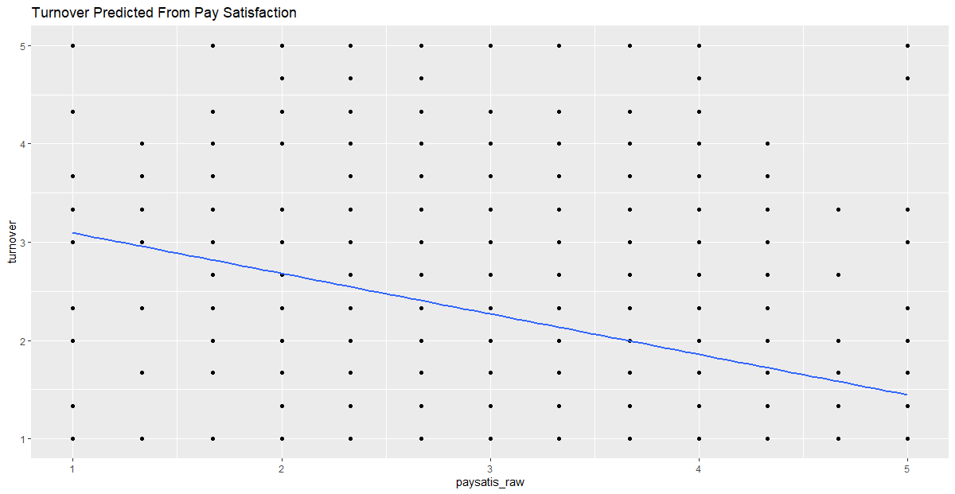
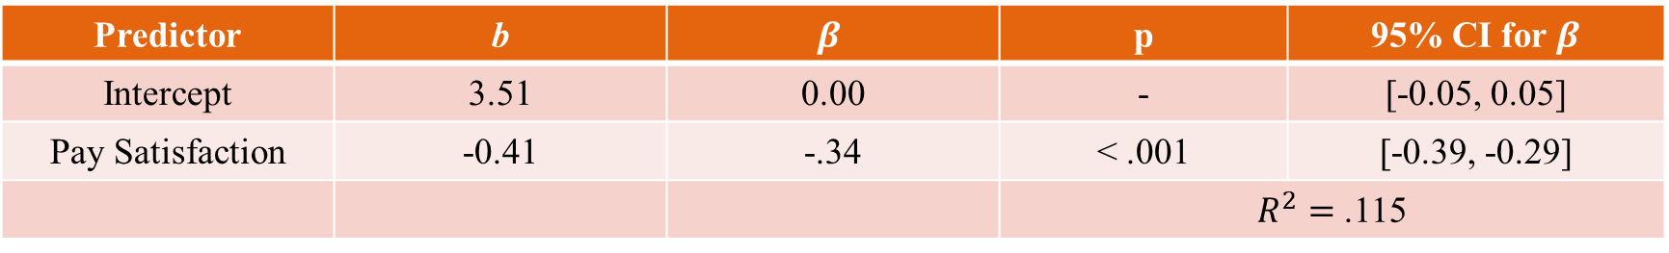
Simple Regression: Turnover ~ Pay Satisfaction
Predictor | b | $$β$$ | p | 95% CI for $β$
Intercept | 3.51 | 0.00 | - | [-0.05, 0.05]
Pay Satisfaction | -0.41 | -.34 | < .001 | [-0.39, -0.29]
 |  |  | $R^{2}=$ .115

Slide 5

Interpretation: Turnover ~ Pay Satisfaction
Predictor | b | $$β$$ | p | 95% CI for $β$
Intercept | 3.51 | 0.00 | - | [-0.05, 0.05]
Pay Satisfaction | -0.41 | -.34 | < .001 | [-0.39, -0.29]
 |  |  | $R^{2}=$ .116
The predicted level of turnover intentions for individuals with zero pay satisfaction is 3.51.
Not meaningful in this instance because pay satisfaction only measured from 1 to 5 (discussed later)
For every 1-unit increase in pay satisfaction, turnover intentions are predicted to decrease by 0.41 units.
For every 1-standard deviation increase in pay satisfaction, turnover intentions are predicted to decrease by 0.34 standard deviations
Roughly 11.6% of the variation in turnover intentions is explained by pay satisfaction.

Slide 6
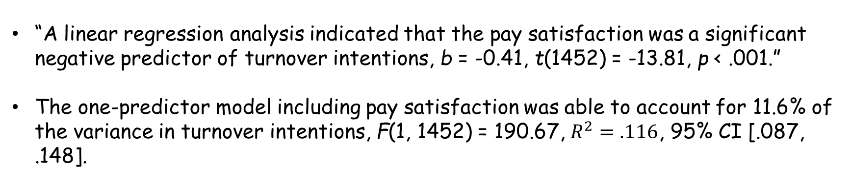
Fancy Write-Up: Turnover ~ Pay Satisfaction
Predictor | b | $$β$$ | p | 95% CI for $β$
Intercept | 3.51 | 0.00 | - | [-0.05, 0.05]
Pay Satisfaction | -0.41 | -.34 | < .001 | [-0.39, -0.29]
 |  |  | $R^{2}=$ .116
“A linear regression analysis indicated that the pay satisfaction was a significant negative predictor of turnover intentions, b = -0.41, t(1452) = -13.81, p < .001.”
The one-predictor model including pay satisfaction was able to account for 11.6% of the variance in turnover intentions, F(1, 1452) = 190.67, $R^{2}=.116$, 95% CI [.087, .148].

Slide 7
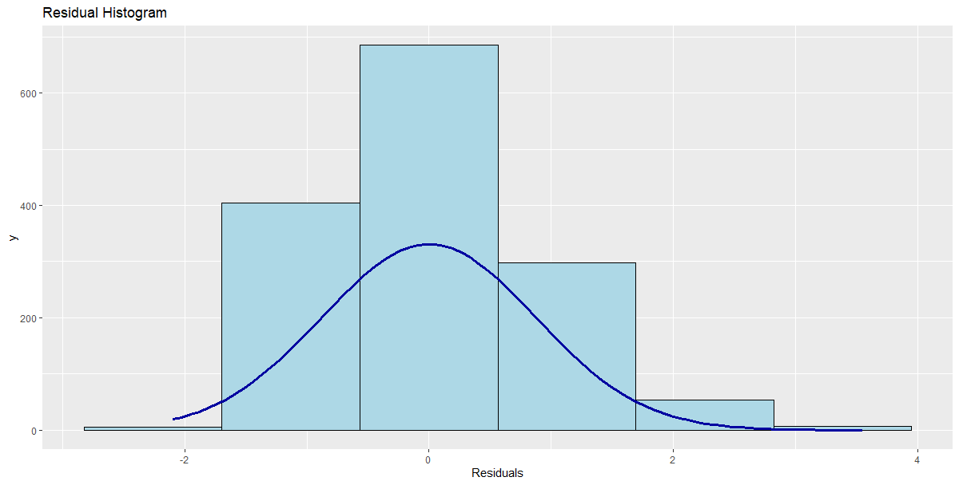
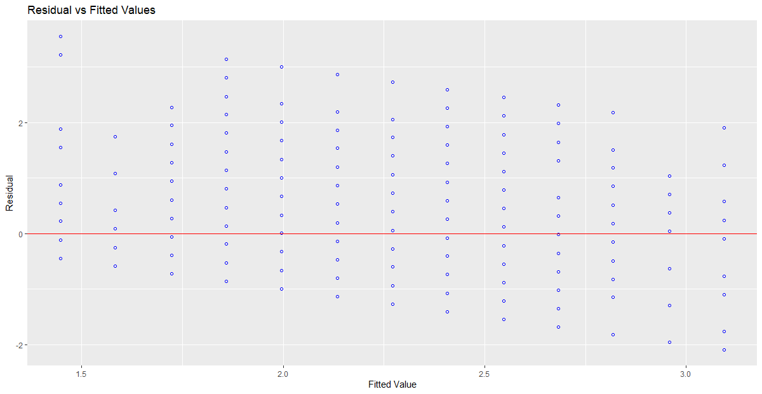
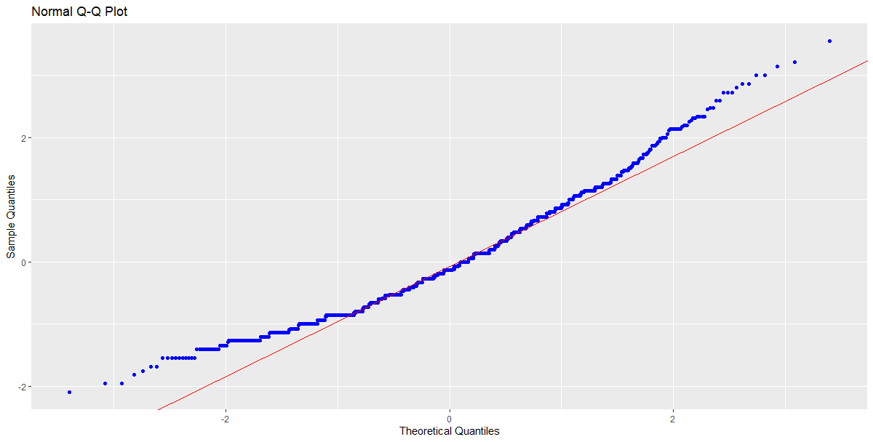
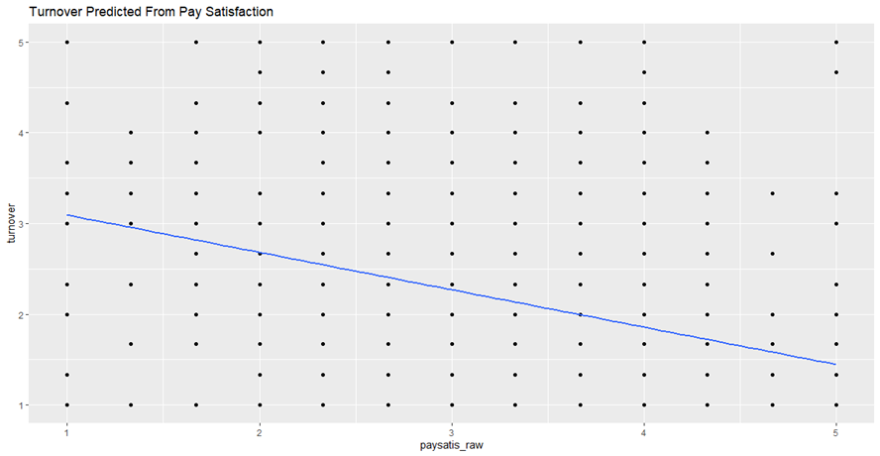
Diagnostics: Turnover ~ Pay Satisfaction

Slide 8

Multiple Regression in R
PsychoStat

Slide 9
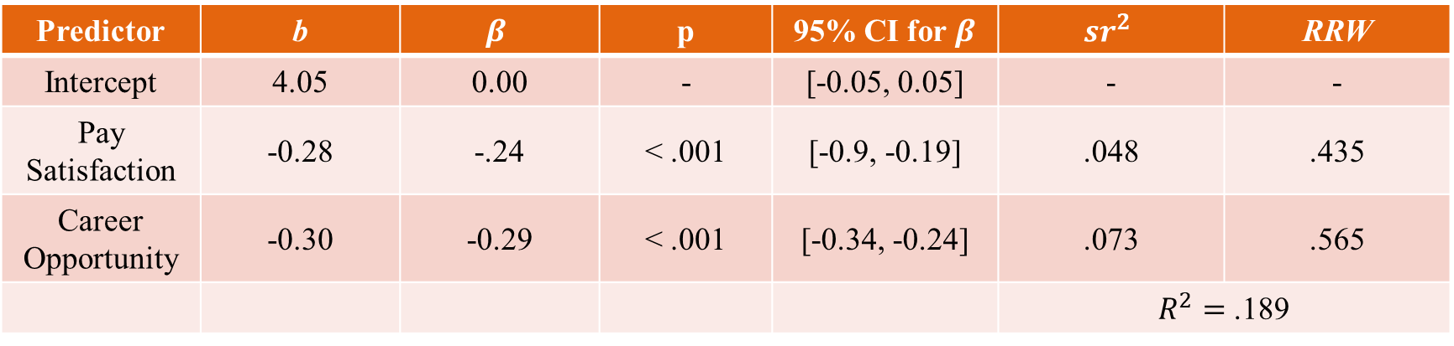
Multiple Reg: Turnover ~ Pay Satisfaction + Career Opportunity
Predictor | b | $$β$$ | p | 95% CI for $β$ | $${sr}^{2}$$ | RRW
Intercept | 4.05 | 0.00 | - | [-0.05, 0.05] | - | -
Pay Satisfaction | -0.28 | -.24 | < .001 | [-0.9, -0.19] | .048 | .435
Career Opportunity | -0.30 | -0.29 | < .001 | [-0.34, -0.24] | .073 | .565
 |  |  |  |  | $R^{2}=$ .189
Note. RRW = Rescaled Relative Weights; ${sr}^{2}$= squared semi-partial correlations

Slide 10
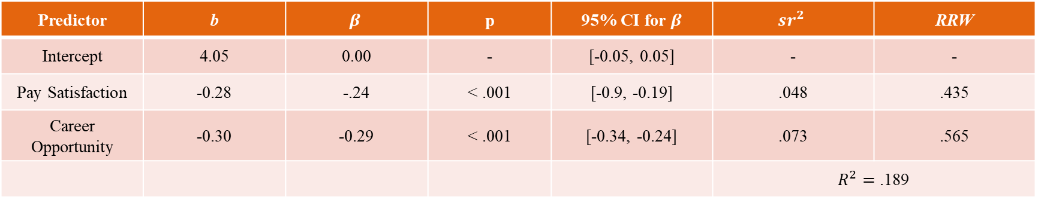
Interpretation (1): Turnover ~ Pay Satisfaction + Career Opportunity
Predictor | b | $$β$$ | p | 95% CI for $β$ | $${sr}^{2}$$ | RRW
Intercept | 4.05 | 0.00 | - | [-0.05, 0.05] | - | -
Pay Satisfaction | -0.28 | -.24 | < .001 | [-0.9, -0.19] | .048 | .435
Career Opportunity | -0.30 | -0.29 | < .001 | [-0.34, -0.24] | .073 | .565
 |  |  |  |  | $R^{2}=$ .189
The predicted level of T/O intent for individuals with zero pay satisfaction and zero career opp is 4.05.
For every 1-unit increase in pay satisfaction, T/O intent is predicted to decrease by 0.28 units, controlling for perceived career opportunity.
Comparing employees who have the same perceived career opportunities, but who differ by 1 unit on pay satisfaction, we would expect a difference in T/O intentions of -0.28 units
For every 1-unit increase in perceived career opportunity, T/O intent is predicted to decrease by 0.30 units, controlling for pay satisfaction.
Comparing employees who have the same pay satisfaction, but who differ by 1 unit on perceived career opportunities, we would expect a difference in T/O intentions of -0.30 units

Slide 11
Interpretation (2): Turnover ~ Pay Satisfaction + Career Opportunity
Predictor | b | $$β$$ | p | 95% CI for $β$ | $${sr}^{2}$$ | RRW
Intercept | 4.05 | 0.00 | - | [-0.05, 0.05] | - | -
Pay Satisfaction | -0.28 | -.24 | < .001 | [-0.9, -0.19] | .048 | .435
Career Opportunity | -0.30 | -0.29 | < .001 | [-0.34, -0.24] | .073 | .565
 |  |  |  |  | $R^{2}=$ .189
For every 1-SD increase in pay satisfaction, T/O intentions are predicted to decrease by 0.24 SD’s when controlling for perceived career opp. For every 1-SD increase in perceived career opp, T/O intentions are predicted to decrease by 0.29 SD’s when controlling for pay satisfaction
Of all the variation in turnover intentions, about 4.8% is uniquely explained by pay satisfaction, and about 7.3% is uniquely explained by perceived career opportunities
Of the variation in T/O intentions explained by the model, about 44% is explained by pay satisfaction, and about 57% is explained by perceived career opportunities
Roughly 19% of the variation in T/O intentions can be explained by the model including these 2 predictors

Slide 12
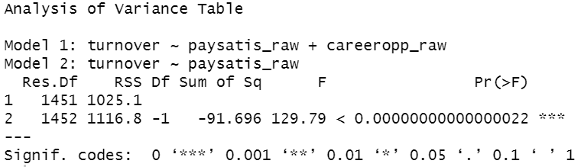
Nested (Hierarchical) Model Comparison
Do perceptions regarding career opportunity predict turnover intentions above and beyond pay satisfaction?
Does adding perceived career opportunities to the model containing pay satisfaction significantly increase model fit?
Yes!

Slide 13
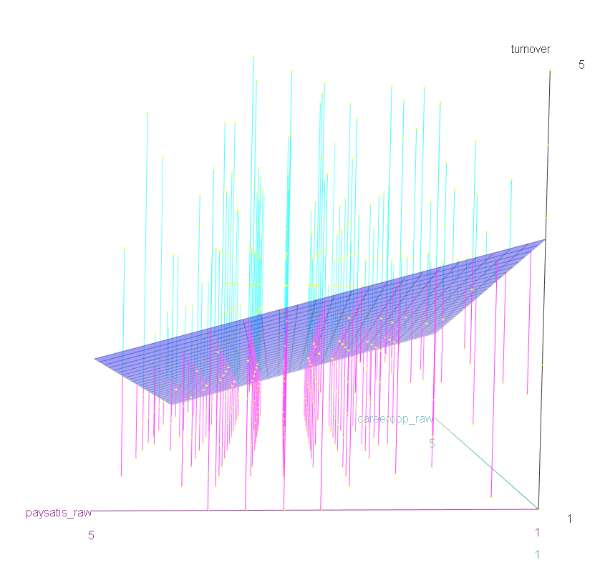
Visualization: Turnover ~ Pay Satisfaction + Career Opps

Slide 14
Diagnostics: Turnover ~ Pay Satisfaction + Career Opp

Slide 15
Categorical Predictors in R

Slide 16

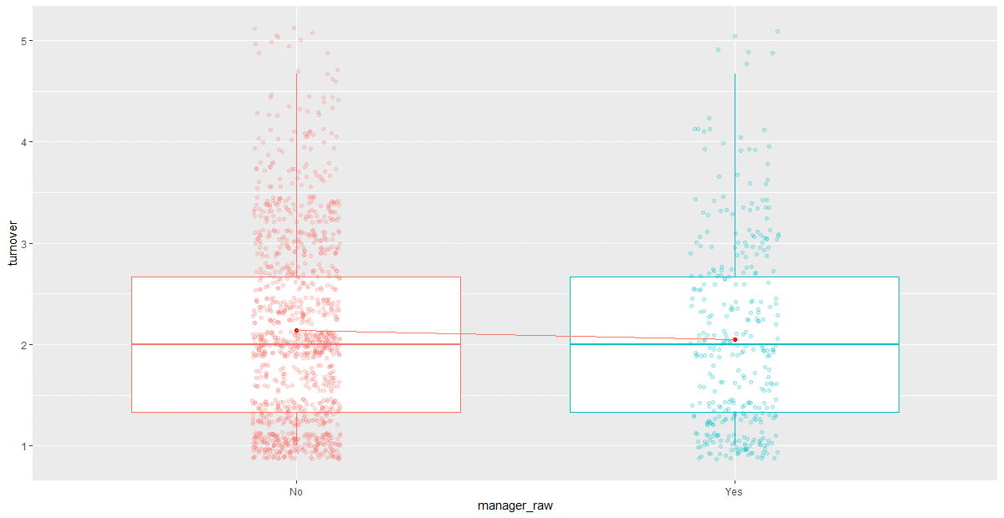

Slide 17
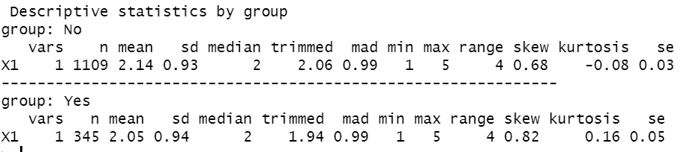
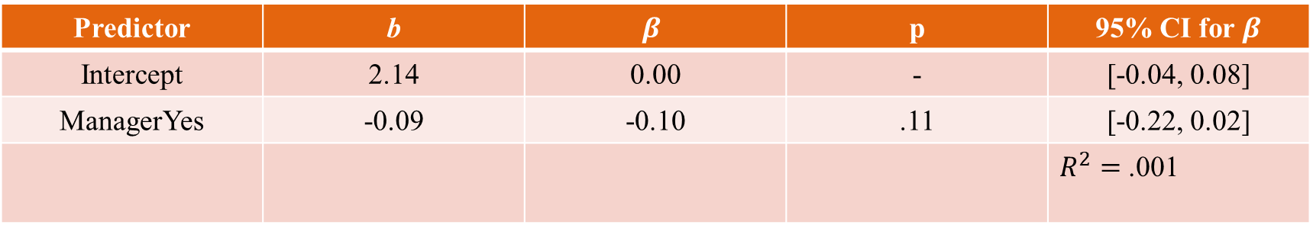
Simple Reg: Turnover ~ Manager Status
Predictor | b | $$β$$ | p | 95% CI for $β$
Intercept | 2.14 | 0.00 | - | [-0.04, 0.08]
ManagerYes | -0.09 | -0.10 | .11 | [-0.22, 0.02]
 |  |  |  | $R^{2}=$ .001

Slide 18
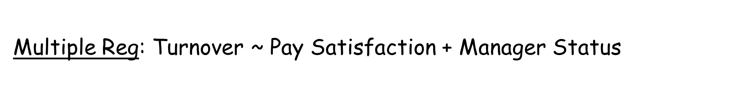
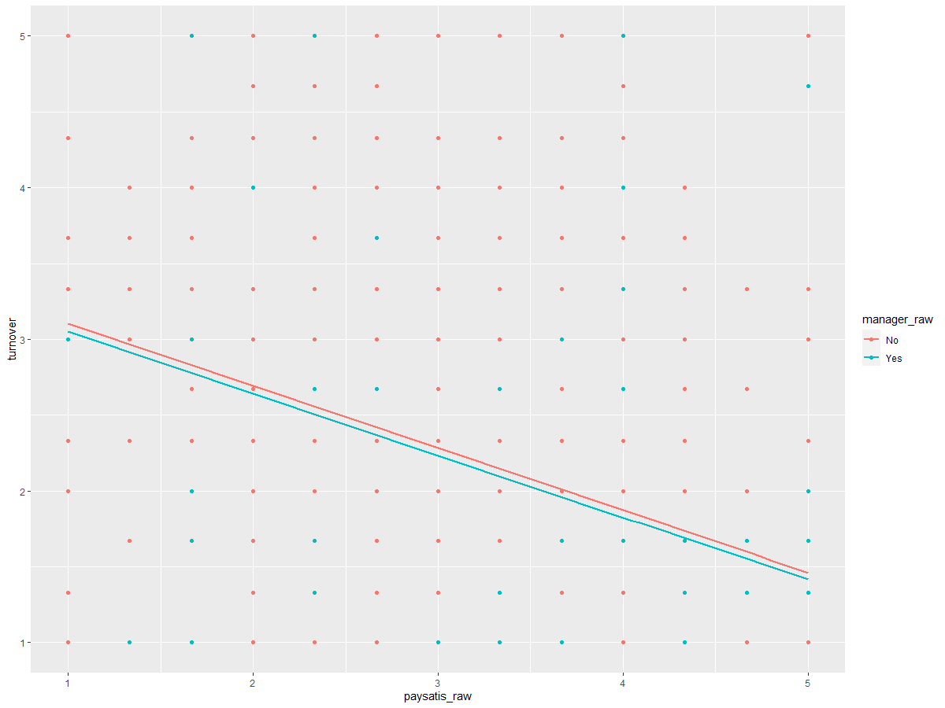

Slide 19
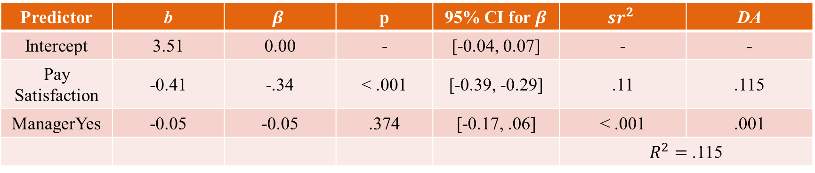
Multiple Reg: Turnover ~ Pay Satisfaction + Manager Status
Predictor | b | $$β$$ | p | 95% CI for $β$ | $${sr}^{2}$$ | DA
Intercept | 3.51 | 0.00 | - | [-0.04, 0.07] | - | -
Pay Satisfaction | -0.41 | -.34 | < .001 | [-0.39, -0.29] | .11 | .115
ManagerYes | -0.05 | -0.05 | .374 | [-0.17, .06] | < .001 | .001
 |  |  |  |  | $R^{2}=$ .115
Note. DA = Dominance Analysis average; ${sr}^{2}$= squared semi-partial correlations

Slide 20
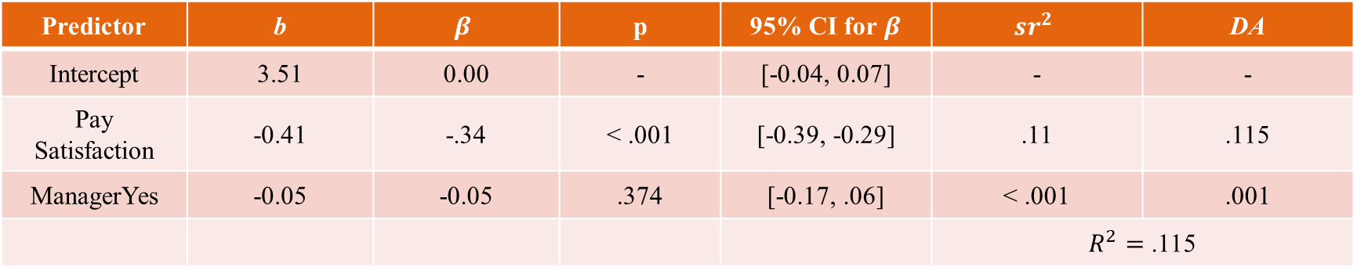
Interpretation (1): Turnover ~ Pay Satisfaction + Manager Status
Predictor | b | $$β$$ | p | 95% CI for $β$ | $${sr}^{2}$$ | DA
Intercept | 3.51 | 0.00 | - | [-0.04, 0.07] | - | -
Pay Satisfaction | -0.41 | -.34 | < .001 | [-0.39, -0.29] | .11 | .115
ManagerYes | -0.05 | -0.05 | .374 | [-0.17, .06] | < .001 | .001
 |  |  |  |  | $R^{2}=$ .115
The predicted level of T/O intent for non-managers with zero pay satisfaction is 3.51.
For every 1-unit increase in pay satisfaction, T/O intent is predicted to decrease by 0.41 units, controlling for manager status.
Comparing employees who have the same manager status, but who differ by 1 unit on pay satisfaction, we would expect a difference in T/O intentions of -0.41 units
Comparing employees who have the same pay satisfaction, we would expect a difference in T/O intentions between managers and non-managers of -0.05 units
Note that this slope/difference is not significant in this case

Slide 21
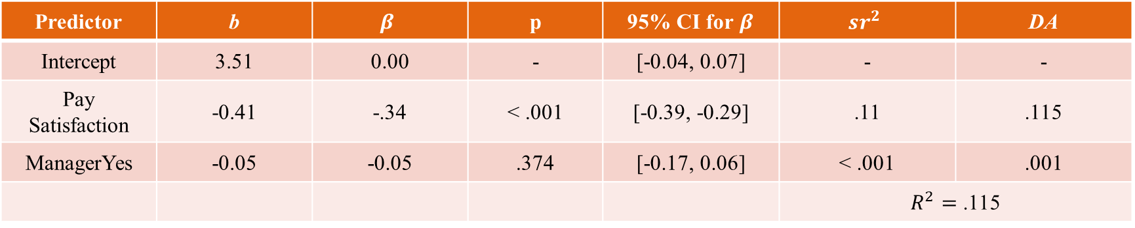
Interpretation (2): Turnover ~ Pay Satisfaction + Manager Status
Predictor | b | $$β$$ | p | 95% CI for $β$ | $${sr}^{2}$$ | DA
Intercept | 3.51 | 0.00 | - | [-0.04, 0.07] | - | -
Pay Satisfaction | -0.41 | -.34 | < .001 | [-0.39, -0.29] | .11 | .115
ManagerYes | -0.05 | -0.05 | .374 | [-0.17, 0.06] | < .001 | .001
 |  |  |  |  | $R^{2}=$ .115
For every 1-SD increase in pay satisfaction, T/O intentions are predicted to decrease by 0.34 SD’s when controlling for manager status. The standardized coefficient for manager status is non-sensical.
Of all the variation in turnover intentions, about 11% is uniquely explained by pay satisfaction, and less than .01% is uniquely explained by manager status
Dominance analysis results confirm that pay satisfaction has a drastically greater “relative importance”
Roughly 11.6% of the variation in T/O intentions can be explained by the model including these 2 predictors

Slide 22
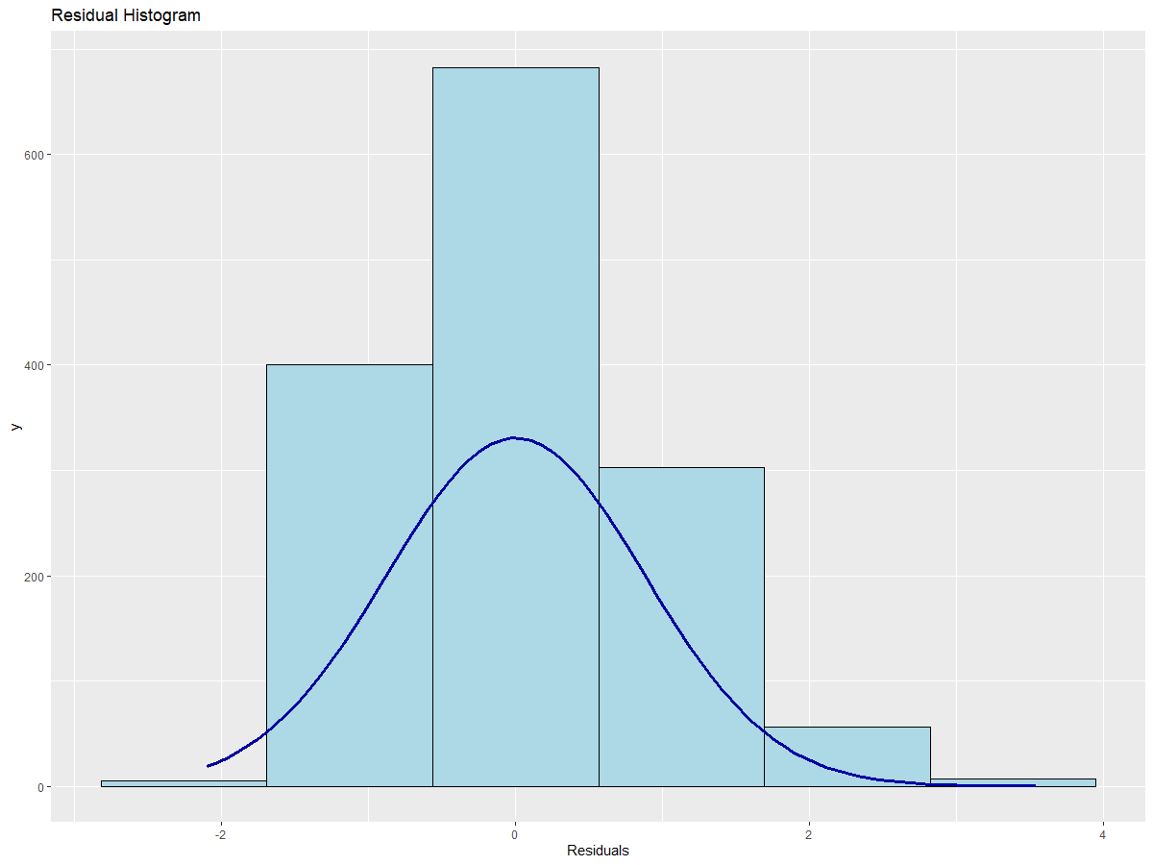
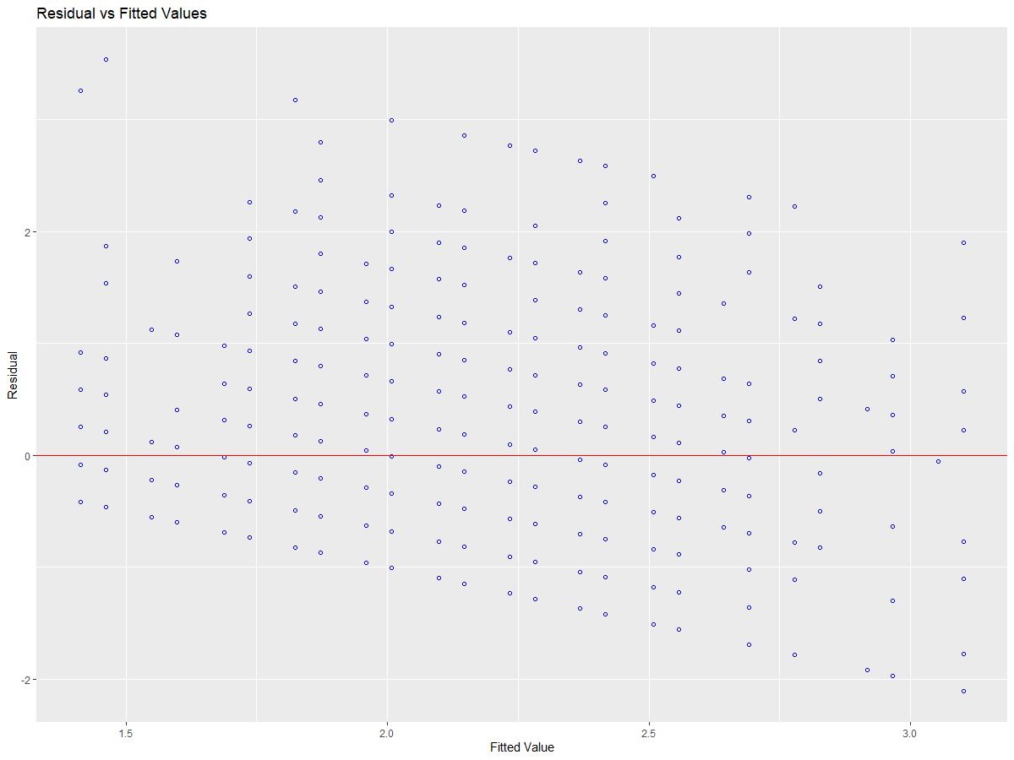
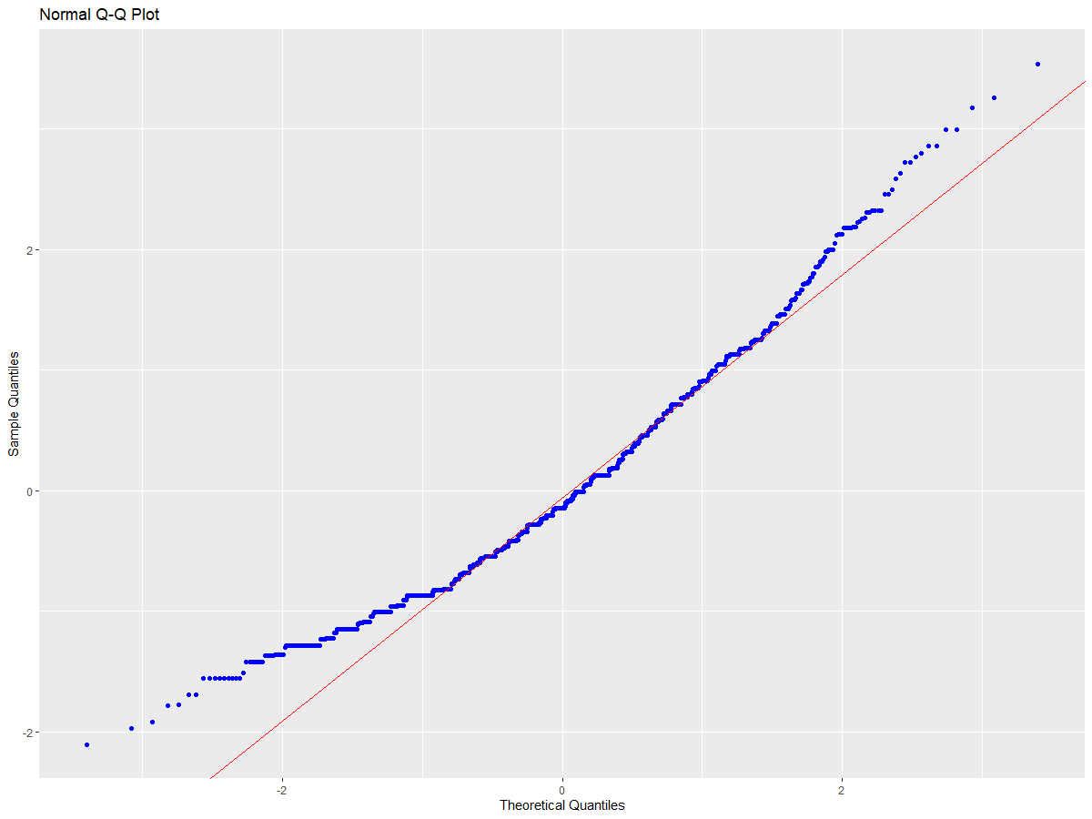
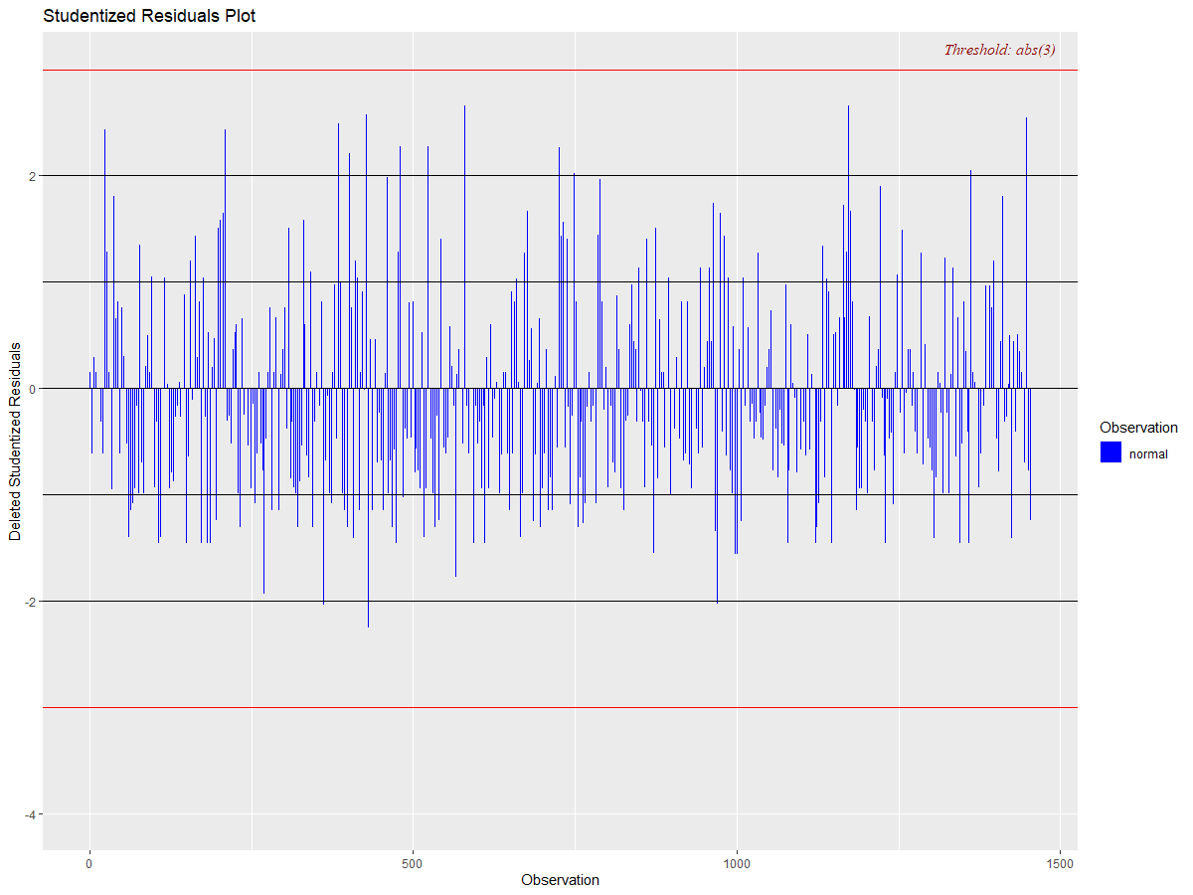
Diagnostics: Turnover ~ Pay Satisfaction + Manager Status

Slide 23
Mean-Centering Predictors

Slide 24
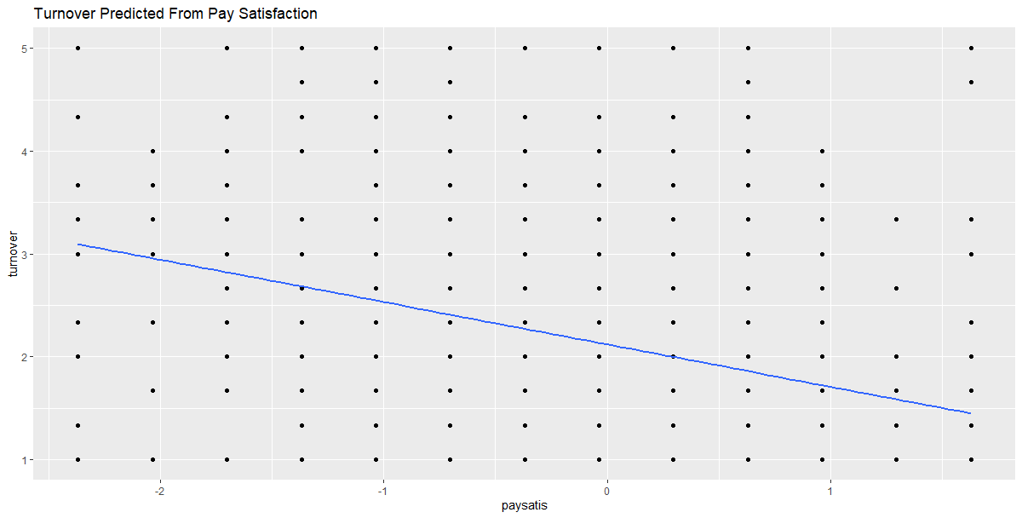
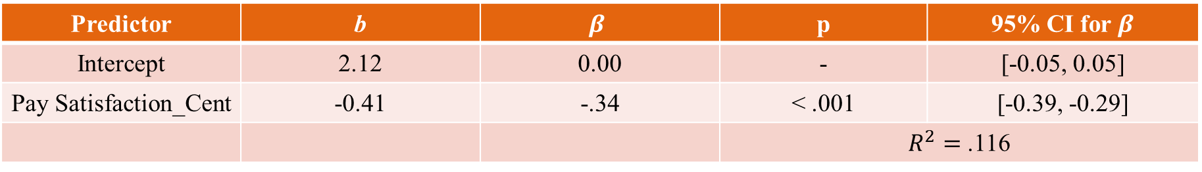
Mean_Centered: Turnover ~ Pay Satisfaction
Predictor | b | $$β$$ | p | 95% CI for $β$
Intercept | 2.12 | 0.00 | - | [-0.05, 0.05]
Pay Satisfaction_Cent | -0.41 | -.34 | < .001 | [-0.39, -0.29]
 |  |  | $R^{2}=$ .116

Slide 25
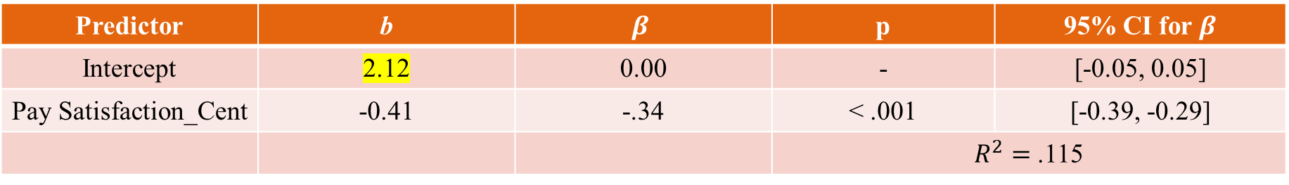
Mean-Centered: Turnover ~ Pay Satisfaction
Predictor | b | $$β$$ | p | 95% CI for $β$
Intercept | 2.12 | 0.00 | - | [-0.05, 0.05]
Pay Satisfaction_Cent | -0.41 | -.34 | < .001 | [-0.39, -0.29]
 |  |  | $R^{2}=$ .115
The predicted level of turnover intentions for individuals with average levels of pay satisfaction is 2.12.
For every 1-unit increase in pay satisfaction, turnover intentions are predicted to decrease by 0.41 units.
Mean-centering does not change the slope, just the intercept!
For every 1-standard deviation increase in pay satisfaction, turnover intentions are predicted to decrease by 0.34 standard deviations
Roughly 11.5% of the variation in turnover intentions is explained by pay satisfaction.

Slide 26
The way to get started is to quit talking and begin doing.
Walt Disney

Slide 27





TEAM
Name
Title
Name
Title
Name
Title
Name
Title
Name
Title

Slide 28
Timeline
To start a presentation, go to the Slide Show tab, and select From Beginning.
1
To display Presenter view, in Slide Show view, on the control bar at the bottom left select the three dots, and then Show Presenter View.
2
During your presentation, the speaker notes are visible on your monitor, but aren't visible to the audience.
3
The Notes pane is a box that appears below each slide. Tap it to add notes.
4
If you don’t see the Notes pane or it is completely minimized, click Notes on the task bar across the bottom of the PowerPoint window.
5

Slide 29
Content
Subtitle
Subtitle
Add text, images, art, and videos.
Add transitions, animations, and motion.
Save to OneDrive, to get to your presentations from your computer, tablet, or phone.
Open the Design Ideas pane for instant slide makeovers.
When we have design ideas, we’ll show them to you right there.

Slide 30
Content
Subtitle
Subtitle
Subtitle
Add text, images, art, and videos.
Add transitions, animations, and motion.
Save to OneDrive, to get to your presentations from your computer, tablet, or phone.
Open the Design Ideas pane for instant slide makeovers.
When we have design ideas, we’ll show them to you right there.
This PowerPoint theme uses its own unique set of colors, fonts, and effects to create the overall look and feel of these slides.
PowerPoint has tons of themes to give your presentation just the right personality.

Slide 31

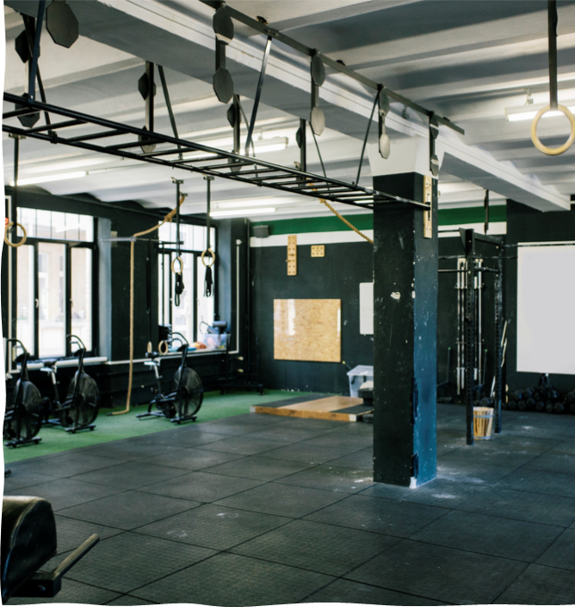
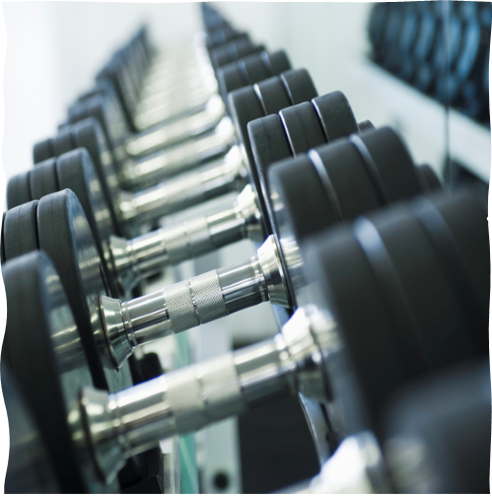

Summary
With PowerPoint, you can create presentations and share your work with others, wherever they are. Type the text you want here to get started. You can also add images, art, and videos on this template. Save to OneDrive and access your presentations from your computer, tablet, or phone.

Slide 32



Thank you
Presenter name
Email address
Website

